Slide 1
Statistical and Predictive Modeling Final Project
Name of the Student: Maisha Khatoon Student ID: 100899259

Slide 2
Problem Statement
Mr. John Hughes requested three predictive models (Logistic Regression, Naïve Bayes, and Voting Ensemble) to anticipate customer attrition. The idea is to determine which variables contribute the most to customers leaving the service and then utilize that information to anticipate future churn.

Slide 3
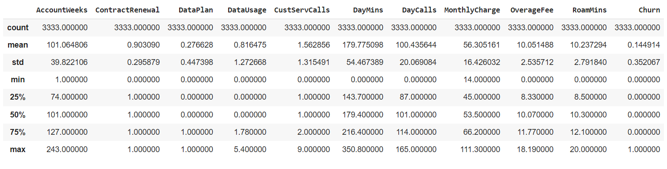
Key Statistics

Slide 4
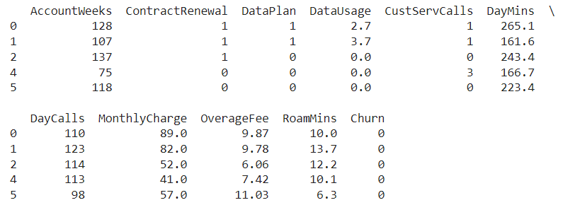
Outlier Treatment: Feature Engineering

Slide 5
Data Description
The dataset contains 3,333 observations and 11 variables, including:
AccountWeeks: How long a customer has been with the company.
ContractRenewal: Whether the customer recently renewed their contract.
DataPlan: Whether the customer has a data plan.
DataUsage: The amount of data the customer uses each month.
CustServCalls: The number of customer service calls made by the customer.
DayMins: Average minutes spent on daytime calls.
DayCalls: Average number of daytime calls.
MonthlyCharge: Average monthly bill amount.
OverageFee: Largest overage fee in the last 12 months.
RoamMins: Average roaming minutes per month.
Churn: Whether the customer canceled the service (this is the target variable).

Slide 6
Key insights from EDA
Contract Renewal Imbalance: The majority of customers (90.3%) have renewed their contracts, indicating a high level of loyalty and satisfaction. This imbalance must be incorporated into the models to avoid biased predictions.
High percentage of zero customer service calls: Approximately 20.9% of consumers have never contacted customer service, which could indicate that they are either extremely satisfied or are unaware of the service choices. This could have an impact on turnover predictions.
Strong Correlation Between Monthly Charge and Overage Fee: Customers with greater overage costs are likely to have higher monthly charges. This shows that frequent overage fees may be a substantial factor in overall consumer expenditures, influencing their decision to stay or leave.

Slide 7
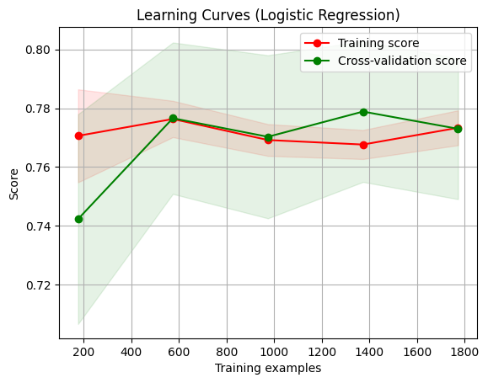
Learning Curves- Logistic Regression
Key Insights:
Convergence of Training and Cross-Validation Scores: According to the learning curve, training and cross-validation scores converge as the number of training cases grows. This suggests that the model is well-generalized, has a balanced trade-off between bias and variance, and does not overfit the data.
Stability with More Data: As the dataset size grows, the scores stabilize, indicating that adding more training data may not significantly improve the model's performance. This demonstrates that the current dataset size is adequate for the Logistic Regression model.

Slide 8
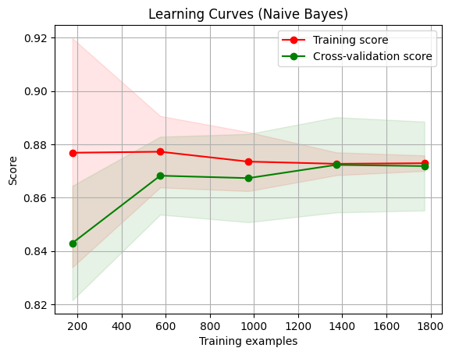
Learning Curves- Naïve Bayes
Key Insights:
High Variance at First: If it applies, a wider difference between training and cross-validation scores for smaller training sizes may be seen in the Naive Bayes learning curve, which would suggest high variance. This implies that the model may be overfit at first but gets better with additional data.
Rapid Stabilization: When additional data is added, the Naive Bayes model may stabilize more quickly than more sophisticated models, with training and cross-validation scores convergent earlier. This indicates that Naive Bayes is an effective model for this classification problem and can do well even with fewer datasets.

Slide 9
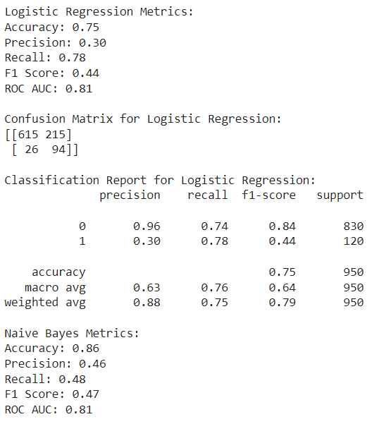
Logistic Regression: Classification Report
Key insights
High Precision for Non-Churn: The model shows a high precision (0.96) for forecasting customers who do not churn (Class 0). This means that 96% of the time, the model is right when it predicts a customer won't churn.
Recall Imbalance: The model captures the majority of churn cases but also generates a sizable number of false positives. For churners (Class 1), the recall is quite high at 0.78, while the accuracy is low at 0.30.
F1 Score Disparity: The model tends to misclassify non-churners even at the cost of catching churn cases, as evidenced by the low F1 score of 0.44 for churners, which represents a trade-off between recall and precision.

Slide 10
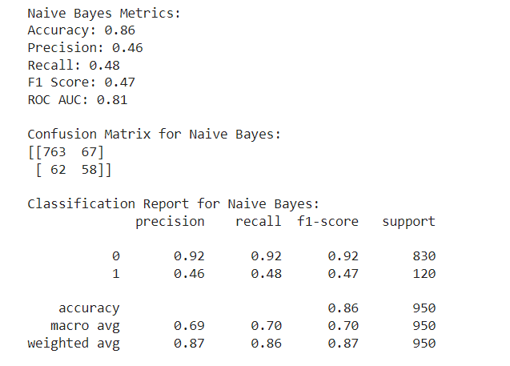
Naïve Bayes: Classification Report
Key insights
Balanced Accuracy: When compared to Logistic Regression, the Naive Bayes model has greater accuracy (0.86) but a lower recall and precision for churners, indicating a balanced but less aggressive approach to capturing churn cases.
Precision and recall for churners (Class 1) are about equal (0.46 and 0.48), resulting in a more balanced but mediocre performance in identifying consumers who are likely to churn.
High Precision for Non-Churners: The Naive Bayes model, like Logistic Regression, has a high precision (0.92) for non-churners, indicating that it is very good at predicting which customers will not churn.

Slide 11
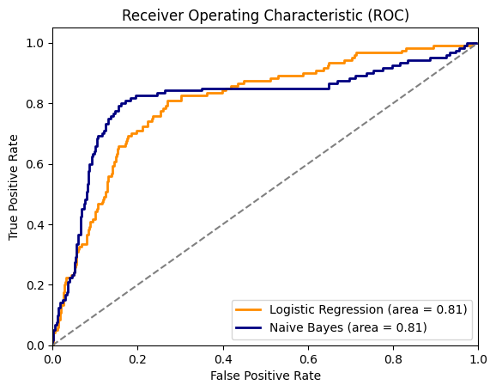
ROC/AUC: Logistic Regression & Naïve Bayes
Key insights
Logistic Regression- AUC Value: The true positive rate and false positive rate are well balanced, as shown by the ROC AUC value of 0.81. When it comes to identifying churners from non-churners, the model does a good job.
Naïve Bayes- AUC Value: The ROC AUC score is 0.81, identical to Logistic Regression, indicating that both models have similar capabilities in distinguishing between churners and non-churners.

Slide 12
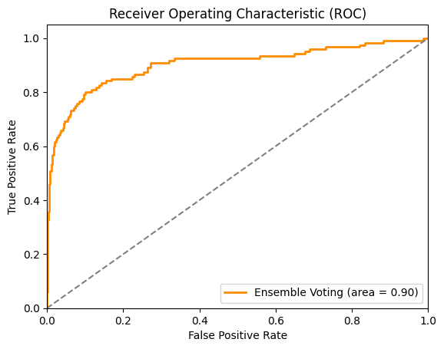
Ensemble Voting Model- ROC/ AUC
Key Insight:
AUC Value: The ROC AUC score of 0.90 indicates strong performance in distinguishing between churners and non-churners, outperforming both Logistic Regression and Naive Bayes.

Slide 13
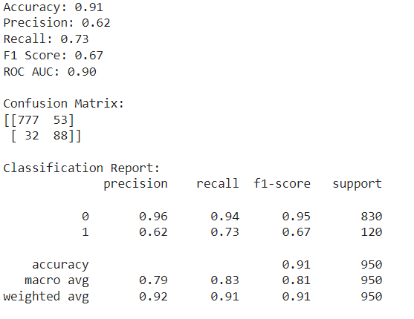
Ensemble Voting Model- Classification Report
Metrics Overview:
Accuracy: 0.91Precision: 0.62Recall: 0.73F1 Score: 0.67ROC AUC: 0.90
Confusion Matrix:
[[777, 53], [32, 88]]
Classification Report Summary:
Class 0 (Non-Churn): Precision = 0.96, Recall = 0.94, F1-Score = 0.95, Support = 830Class 1 (Churn): Precision = 0.62, Recall = 0.73, F1-Score = 0.67, Support = 120

Slide 14
Comparison of Models
Total Precision: In terms of accuracy, the Ensemble Voting model outperformed Logistic Regression (0.75) and Naive Bayes (0.86), with a score of 0.91. This suggests that the overall prediction accuracy can be increased by combining models, in this case, Gradient Boosting and Logistic Regression.
Accuracy and Memory Equilibrium: Compared to lower accuracy in Logistic Regression (0.30) and Naive Bayes (0.46), the Ensemble Voting model offers a superior balance between precision and recall for churn prediction (Class 1), with precision at 0.62 and recall at 0.73. This indicates that without overpredicting, the ensemble model performs better at accurately detecting churners.
Higher ROC AUC: The Ensemble Voting model outperforms both Logistic Regression and Naive Bayes, with respective AUCs of 0.90 and 0.81. This shows that the ensemble model is more effective at identifying which consumers are likely to churn and which ones won't.

Slide 15
Conclusion
Best Model: The Ensemble Voting model performs better on all major criteria compared to Logistic Regression and Naive Bayes, especially when it comes to the balance of precision, recall, and total accuracy.
Practical Implications: Based on its robust performance, the Ensemble Voting model is the best option for predicting customer attrition and should be put into practice.
Next Steps: To improve performance even further, think about incorporating other models or modifying weights to further refine the ensemble.

Slide 16
Thank you.

